Slide 1
CLUSTERING

Slide 2
Clustering
In supervised learning, the data set includes an input X, as well as a target output Y, and the goal of the learning algorithm is to find a decision boundary to classify the data based on the target. In contrast, in unsupervised learning, we just have the input X, without the target label Y. Since we do not have the target label, we are not able to tell the algorithm the right answer that it needs to predict. Instead, we ask the algorithm to find some interesting structure about the data.
A clustering algorithm looks at training data and finds data points that are related or similar to each other. Thus, clustering algorithms look for 1 particular type of structure in the data – grouping of similar data points.
Applications of clustering: grouping of news articles, DNA analysis, Market Segmentation, Astronomical data analysis (grouping bodies of space together for analysis)
K-Means Clustering
This is the most commonly used clustering algorithm
Given a set of data points and the number of clusters that the data points need to be grouped into:
First K-Means will take a random guess at what might be the centers of the K clusters that have been asked to find
These random initial guess might not be particularly good guesses. These guesses optionally could be outside of the training set.
K-Means will then repeatedly do 2 different things:
Assign points to cluster centroid
Move cluster centroid

Slide 3
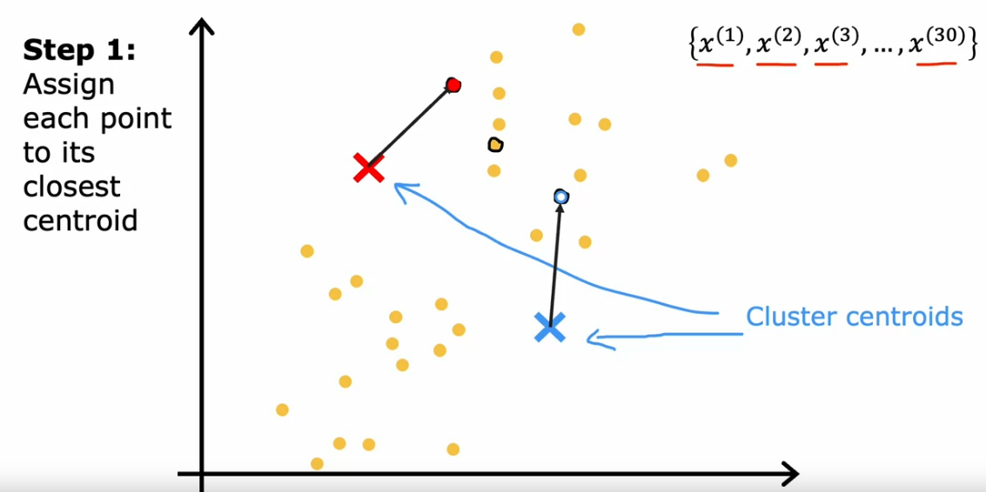
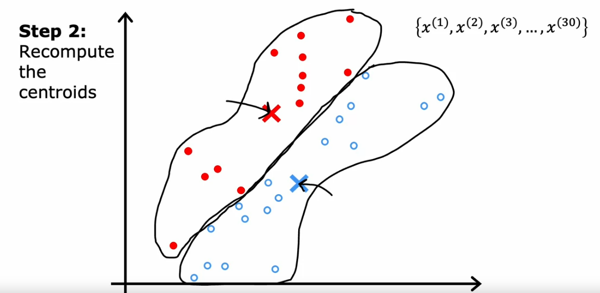
Deep Dive:
1] Assign Points to Cluster Centroids – Each point is evaluated to check which centroid it is the closest to. The algorithm will then assign each point to the closest centroid. This way it will associate each point to one of the cluster centroid
2] Move Cluster Centroid – Then take all of the points associated with the 1st cluster and take their average. This average becomes the new cluster centroid. The same is done for the other clusters.

Slide 4
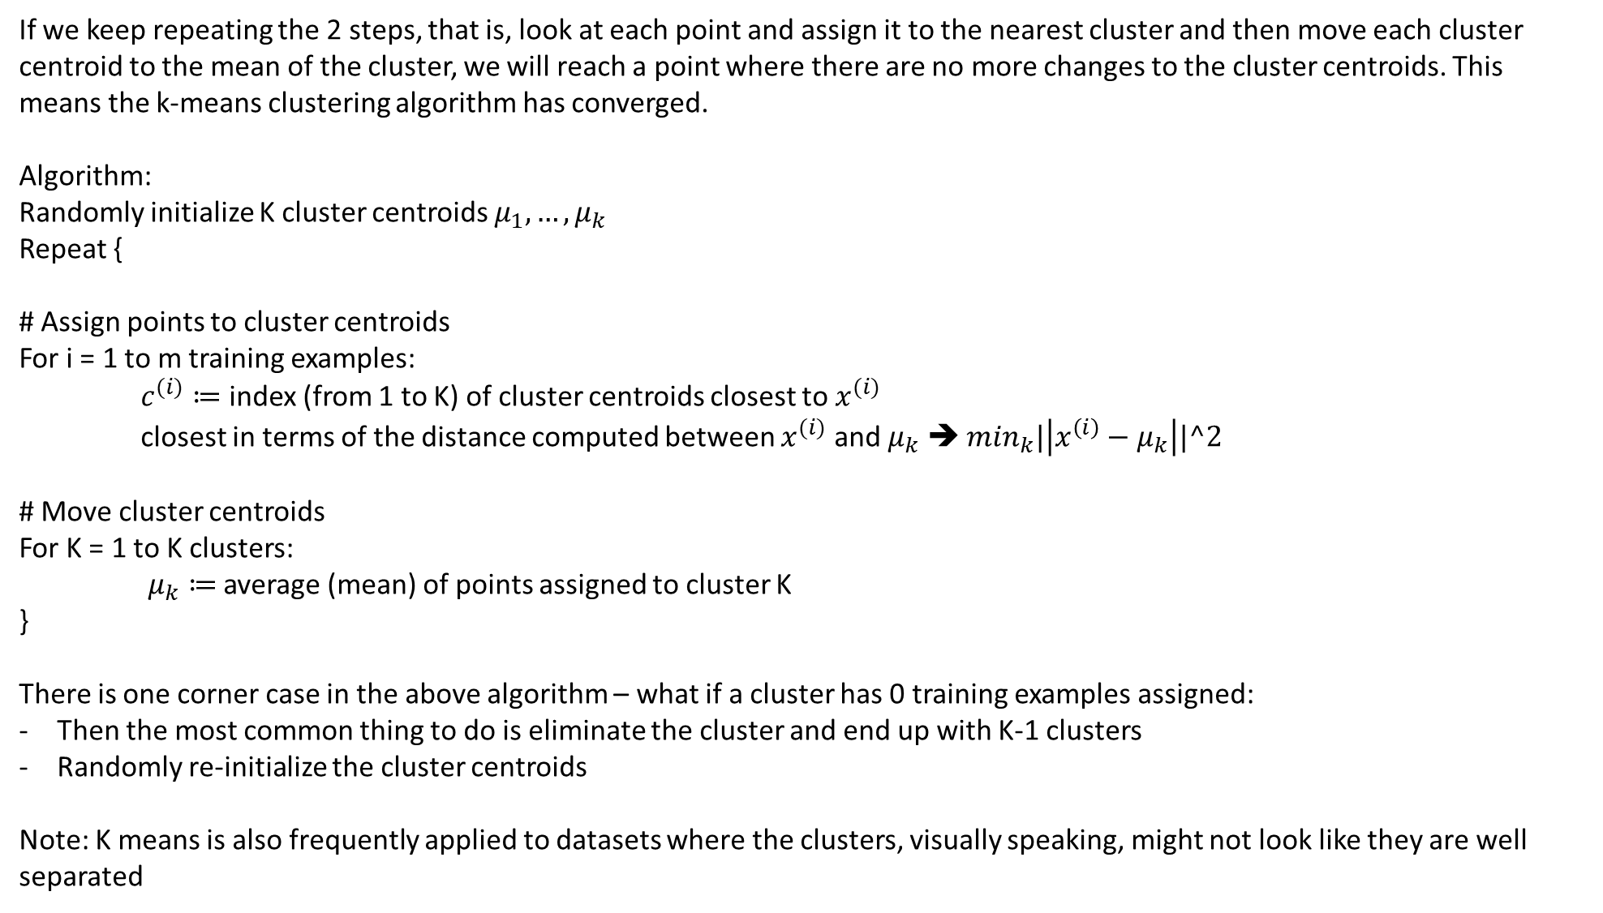
If we keep repeating the 2 steps, that is, look at each point and assign it to the nearest cluster and then move each cluster centroid to the mean of the cluster, we will reach a point where there are no more changes to the cluster centroids. This means the k-means clustering algorithm has converged.
Algorithm:
Randomly initialize K cluster centroids $μ_{1},…,μ_{k}$
Repeat {
# Assign points to cluster centroids
For i = 1 to m training examples:
$c^{(i)}≔$ index (from 1 to K) of cluster centroids closest to $x^{(i)}$
closest in terms of the distance computed between $x^{(i)}$ and $μ_{k}$ ➔ $\min_{k}|\left|x^{\left(i\right)}−μ_{k}\right||^2$
# Move cluster centroids
For K = 1 to K clusters:
$μ_{k}≔$ average (mean) of points assigned to cluster K
}
There is one corner case in the above algorithm – what if a cluster has 0 training examples assigned:
Then the most common thing to do is eliminate the cluster and end up with K-1 clusters
Randomly re-initialize the cluster centroids
Note: K means is also frequently applied to datasets where the clusters, visually speaking, might not look like they are well separated

Slide 5
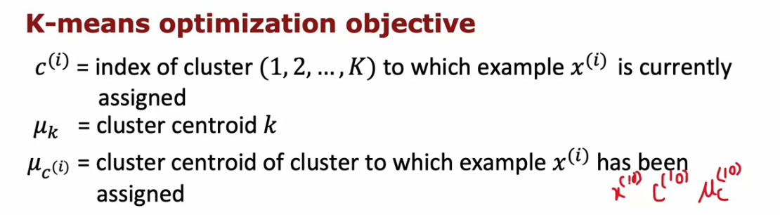
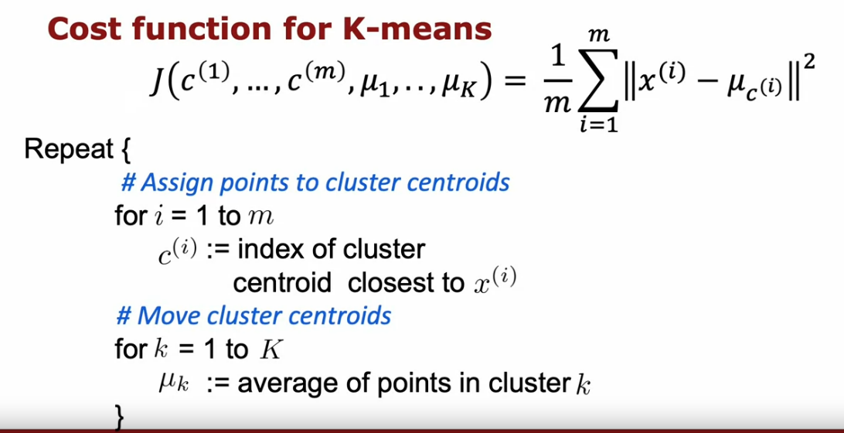
K Means Optimization Objective
The k-means algorithm is also optimizing a cost function, and it is not gradient descent
The cost function for k-means is also called the DISTORTION function. Since k-means is optimizing a squared error cost function, it is guaranteed to converge. Also, the cost can either stay the same or only go down, and never go up. If it does go up, means that there is a bug in the implementation!
If the cost goes down very slowly between the iterations or if it does not change, it usually means that k-means has converged.

Slide 6
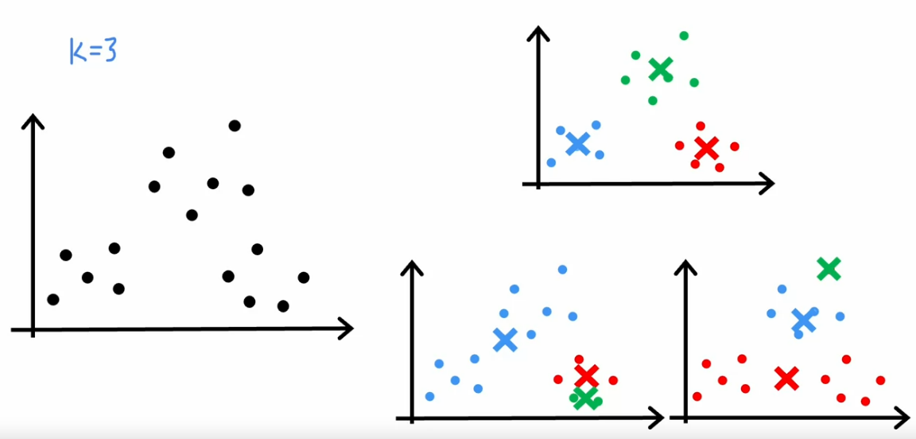
Initializing K
One other way of taking advantage of the cost function is to use multiple different random initializations of cluster centroids. Using this , we often find much better clusters.
When running k-means, always choose the number of clusters to be less than the training examples. If not, it means at most one training example does not belong to 1 cluster.
The most common way to choose centroids is to randomly pick K training examples (K = number of clusters). This is more common than using completely random values outside of the training set. However, the drawback of this approach is that every random init might result in different clusters.

Slide 7
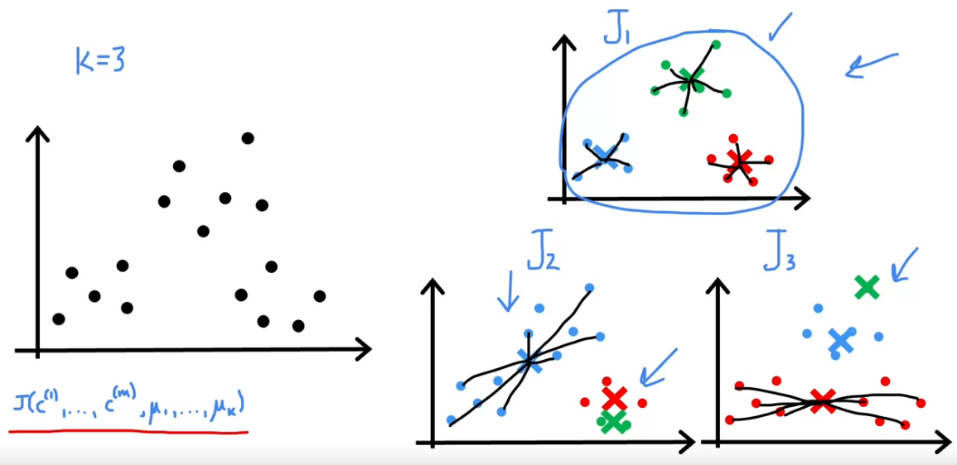
In order to avoid the above issue, one of the things to do is to run the k-means algorithm multiple times. When doing so, compute the cost function J for each run and pick the one that gives the lowest value of the cost function J
In the above example, the cost function J is the lowest for J1. It will be higher for J2 because of the blue clusters and for J3 because of the red cluster. For both these clusters, the data points are more spread leading to a higher intra-cluster distance and thus a higher cost.
P.T.O. – Updated Algo

Slide 8
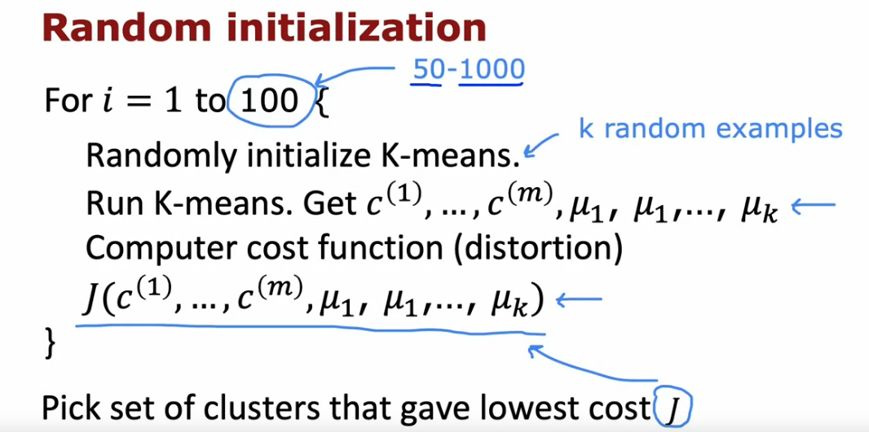
Choosing K
There are a lot of applications in which the data itself does not give a clear indication of the number of clusters.
Elbow Method: Run the k-means for a variety of values of K and plot the cost function J as a function of the number of clusters. Then decide the clusters based on how rapidly the cost decreases till it reaches a certain K.
Problems with the Elbow Method:
This method does not factor in the fact that for a lot of data sets, the number of clusters is truly ambiguous.
Sometimes there is no clear “elbow”. Choosing K to minimize cost J is not a good technique as it always leads to choosing the largest possible value of K because having more clusters will always reduce the cost function J.

Slide 9
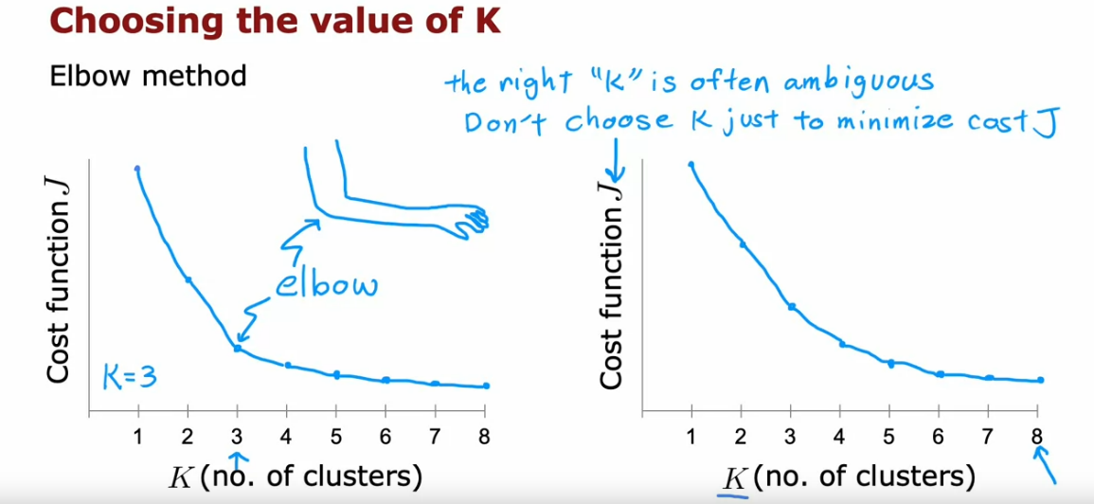
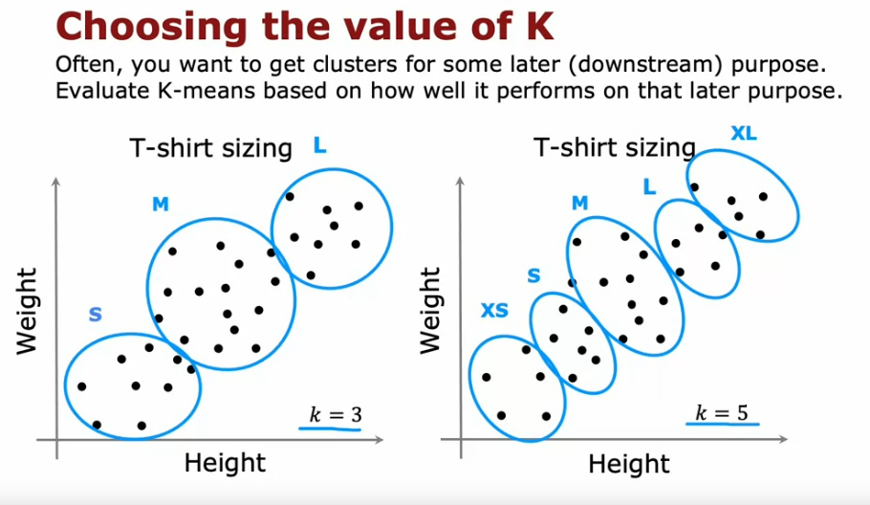
A better way of choosing K is evaluating how well the clusters perform on a later (downstream) application/purpose.

Slide 10
ANOMALY DETECTION

Slide 11
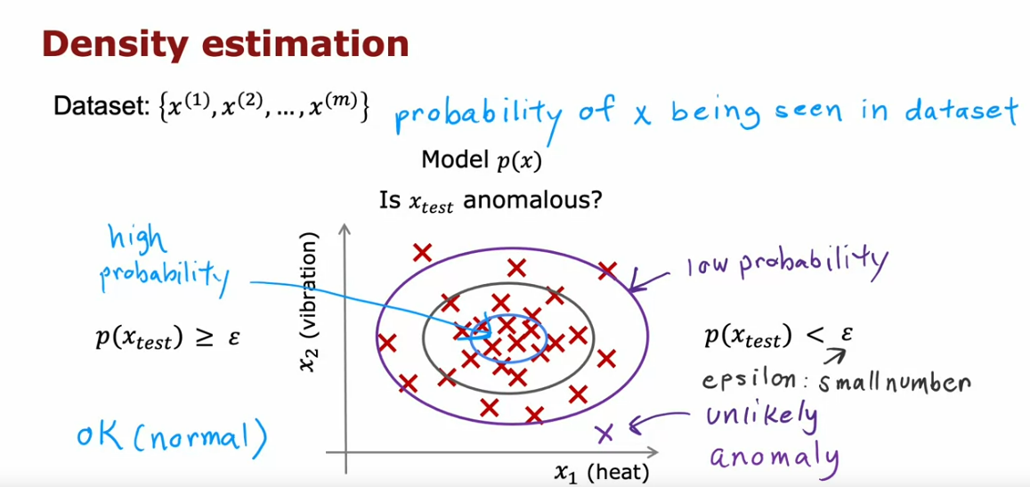
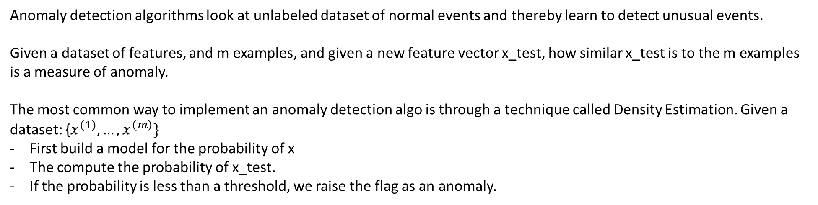
Anomaly detection algorithms look at unlabeled dataset of normal events and thereby learn to detect unusual events.
Given a dataset of features, and m examples, and given a new feature vector x_test, how similar x_test is to the m examples is a measure of anomaly.
The most common way to implement an anomaly detection algo is through a technique called Density Estimation. Given a dataset: {$x^{(1)},…,x^{\left(m\right)}\}$
First build a model for the probability of x
The compute the probability of x_test.
If the probability is less than a threshold, we raise the flag as an anomaly.

Slide 12
Application areas:
1] Fraud Detection – If running a website of many different features, compute x_i to be a feature of the user’s i’s activity. Examples of x_i:
How often does the user login
How many web pages visited
How many transactions made
Posts vs typing speed
After modelling the probability of the above features, if a threshold is breached, the next step could be performing additional checks to identify real vs fraud alarms
2] Manufacturing – Capture feature of products and identify units that behave strangely
3] Monitoring computers in a data center – The features could be the following:
Memory use of the machine
Number of disks accesses/sec
CPU load
CPU load/Network Traffic

Slide 13
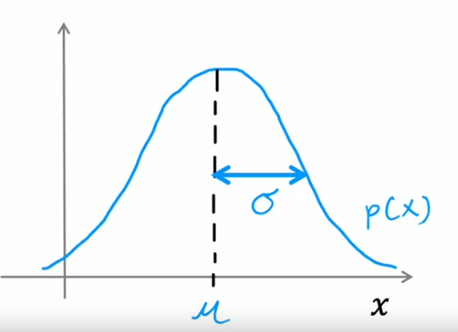
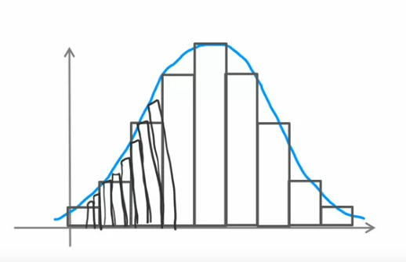
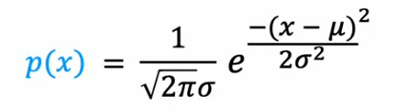
Gaussian Distribution for Anomaly Detection
If x is a random number (also known as a random variable because it can take up random values), and if the probability of x is given by a normal distribution, with a certain mean and variance, it means the probability distribution of x looks like the below curve:
P(x) means that if we get many many numbers drawn from the above probability distribution, and we were to plot a histogram of the many many numbers, it would look like below

Slide 14
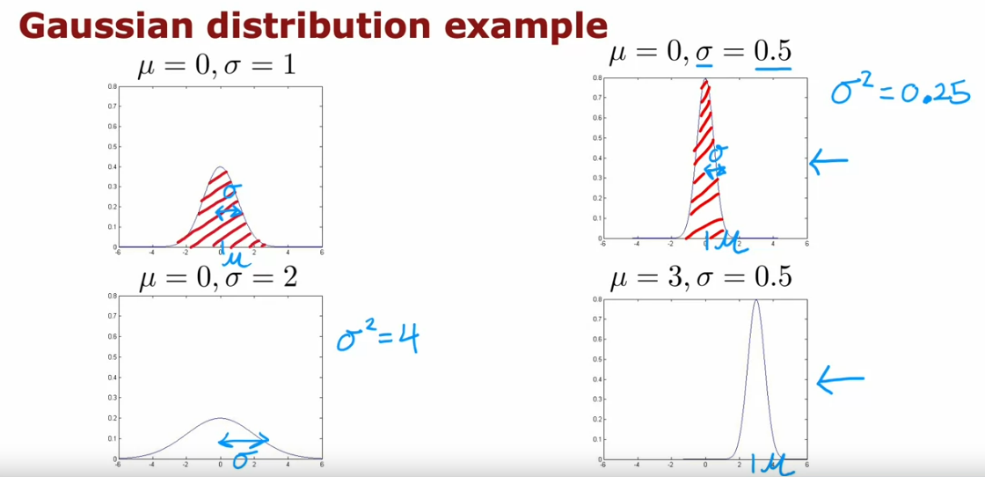
Gaussian Distribution Examples:
Note that the area under the curve for all the below graphs is 1.

Slide 15
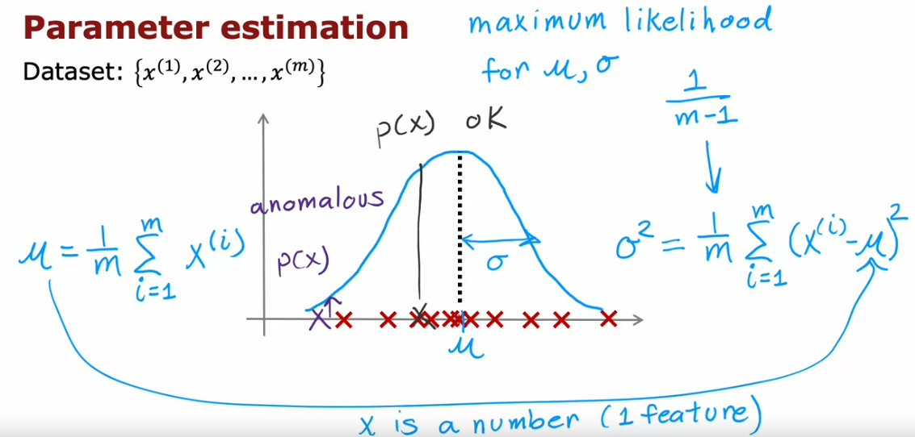
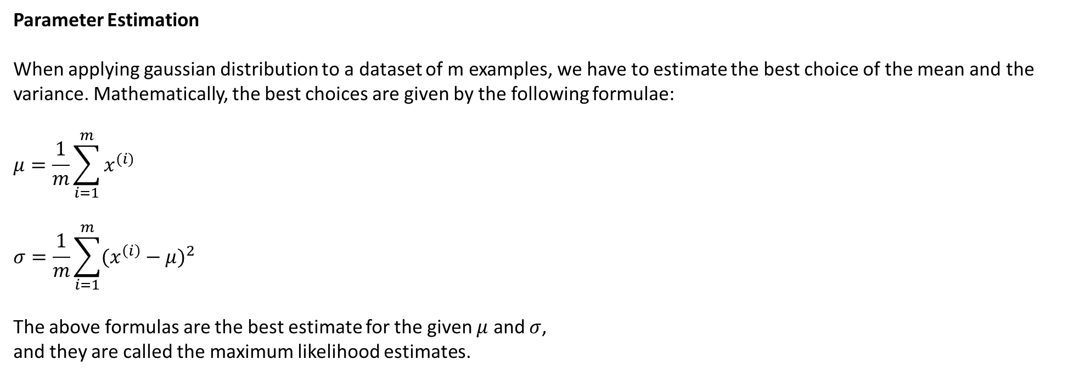
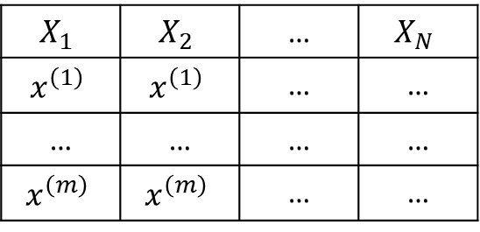
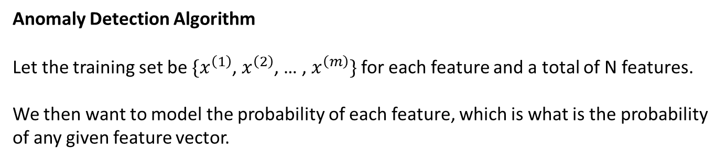
Parameter Estimation
When applying gaussian distribution to a dataset of m examples, we have to estimate the best choice of the mean and the variance. Mathematically, the best choices are given by the following formulae:
$$μ=\frac{1}{m}\sum_{i=1}^{m}{x^{(i)}}$$
$$σ=\frac{1}{m}\sum_{i=1}^{m}{{(x^{\left(i\right)}−μ)}^{2}}$$
The above formulas are the best estimate for the given $μ$ and $σ$,
and they are called the maximum likelihood estimates.
Anomaly Detection Algorithm
Let the training set be ${\{x}^{\left(1\right)}$, $x^{\left(2\right)}$, … , $x^{\left(m\right)}\}$ for each feature and a total of N features.
We then want to model the probability of each feature, which is what is the probability
of any given feature vector.
$$X_{1}$$ | $$X_{2}$$ | … | $$X_{N}$$
$$x^{\left(1\right)}$$ | $$x^{\left(1\right)}$$ | … | …
… | … | … | …
$$x^{\left(m\right)}$$ | $$x^{\left(m\right)}$$ | … | …

Slide 16
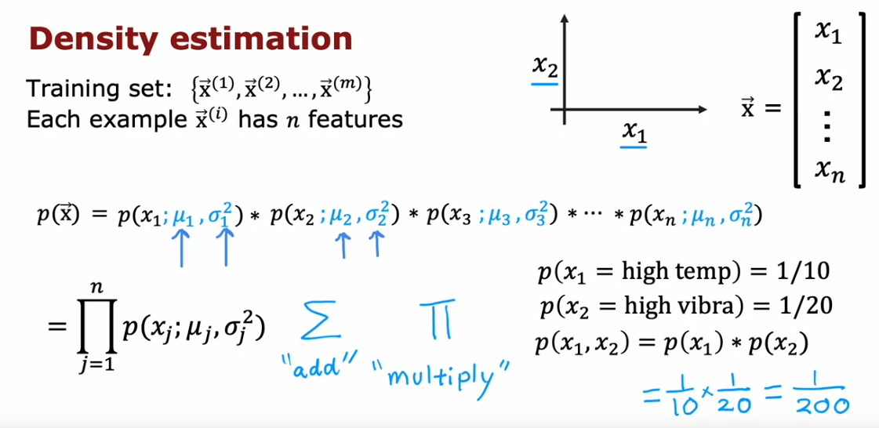
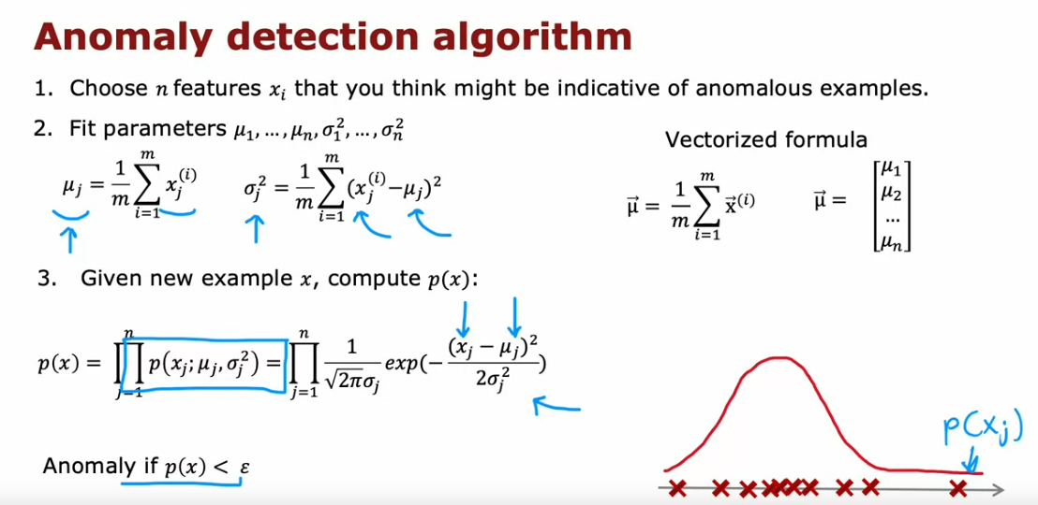
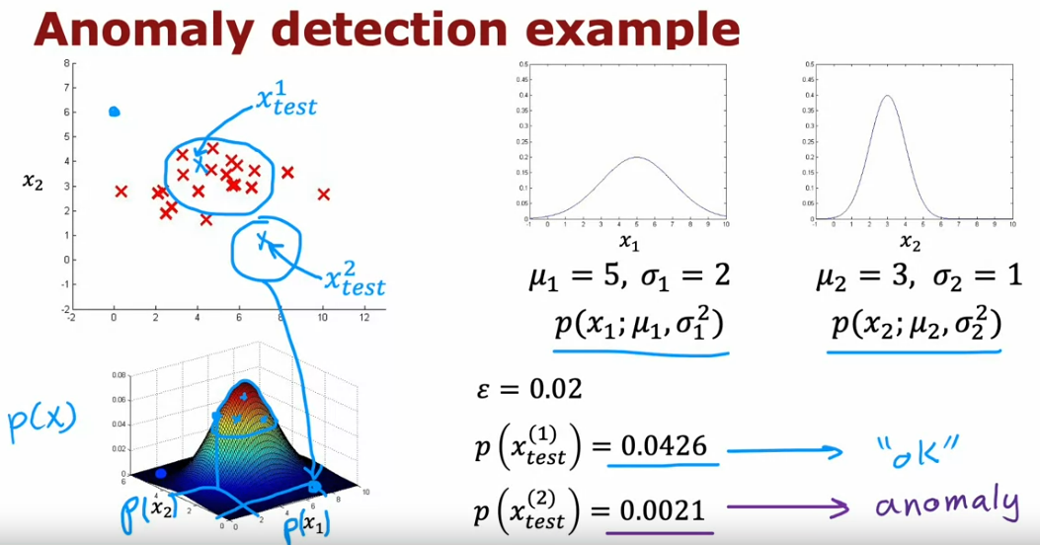
$$p\left(\overline{x}\right)=p\left(x_{1};μ_{1}, σ_{1}^{2}\right)∗p\left(x_{2};μ_{2},σ_{2}^{2}\right)∗…p\left(x_{n};μ_{n},σ_{n}^{2}\right)$$
The above equation assumes that the features are statistically independent. However, the algo works fine even if the features are not statistically independent. We thus model the mean and standard deviation of each feature.
One intuition for the above algorithm is that it will flag an example as anomaly if either 1 or more of the features are very large or very small relative to the training set

Slide 17
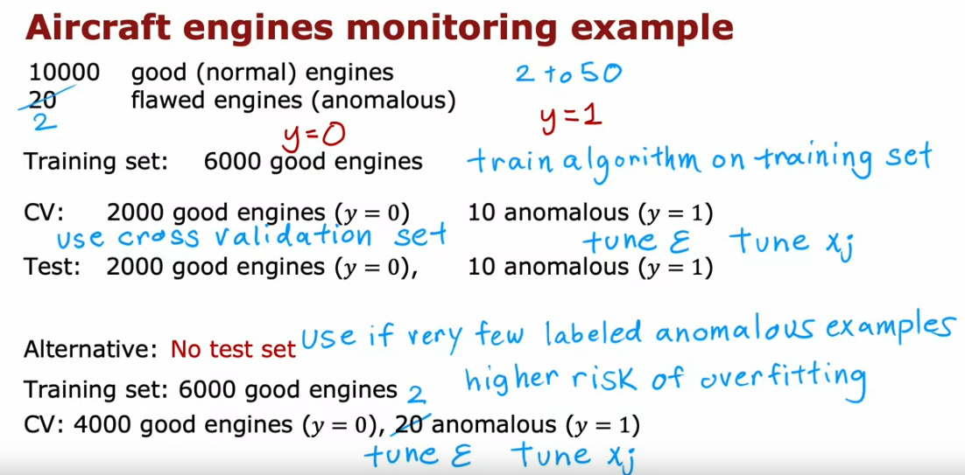
Evaluation of Algorithm
Even though we have unlabeled data, to evaluate anomaly detection, we will assume that we have previously observed anomalies. If we have a small number of anomalous examples, we can create a cross validation and test set to tune the threshold parameter epsilon and/or add/remove features for solving the problem.
Note that anomaly detection is primarily an unsupervised learning algorithm as the training data is unlabelled. However, a small number of anomalies are very helpful to evaluate the algorithm. Also, since the number of anomalies are very small, often using a cross-validation set only to tune the threshold is okay. However, the downside is that after we have tuned the algorithm, we do not have a fair way to comment on its performance on future examples (thus high risk of overfitting).
Once we fit a model on the training set, we can choose a value epsilon and predict/label the examples in the cross-validation set as anomalous or not. We can view calculate the confusion matrix that helps on skewed evaluations and track the performance based on different scores.

Slide 18
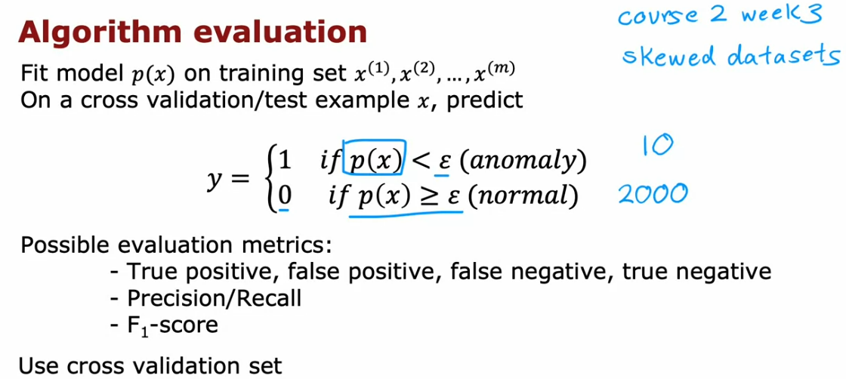
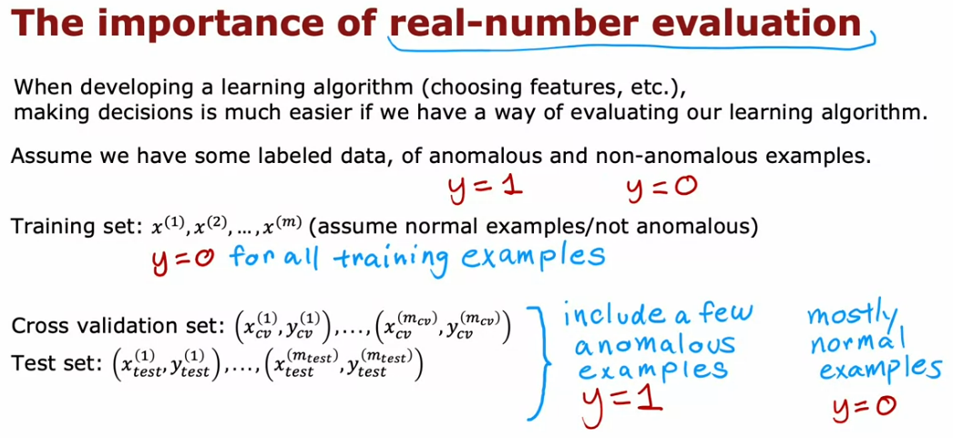
Tune Features for Anomaly Detection
In supervised learning, having additional or noisy features is fine as the algorithm is trying to learn the signals based on the output label. Since anomaly detection runs on unlabelled data, it is harder for the algorithm to figure out which features to ignore. Thus, carefully choosing features is more important for anomaly detection that for supervised learning.
[1] One step is to ensure features are more or less gaussian. On plotting the features, if the distribution is more or less skewed, taking the log(x+c), where x is the feature value and c is an integer > 1, can help transform a feature into a gaussian. Also, upon transforming, only use the transformed feature to model. Another technique is to raise the feature to an exponentiation of ½ (square root), or 1/3 (cube root), etc.
As a remined, any transformation applied on the training set must be applied to the test set as well.

Slide 19
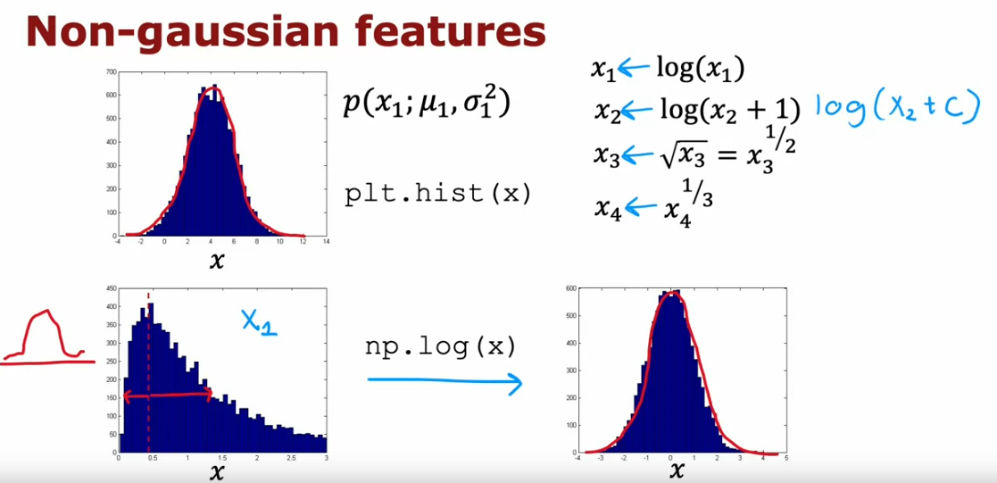
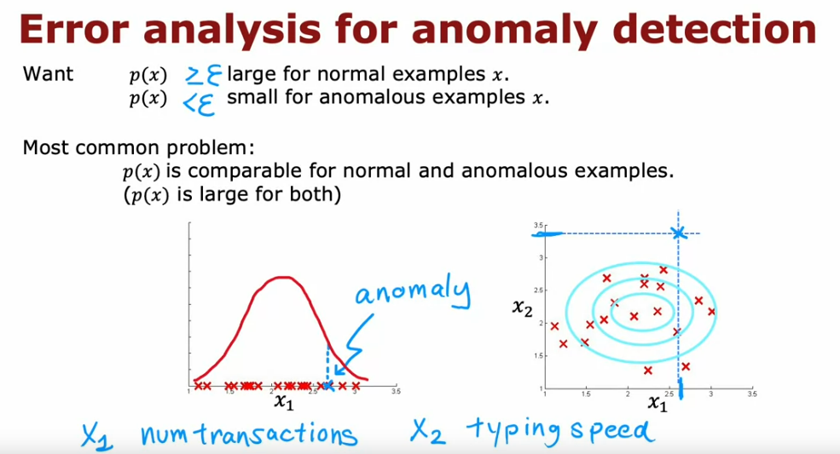
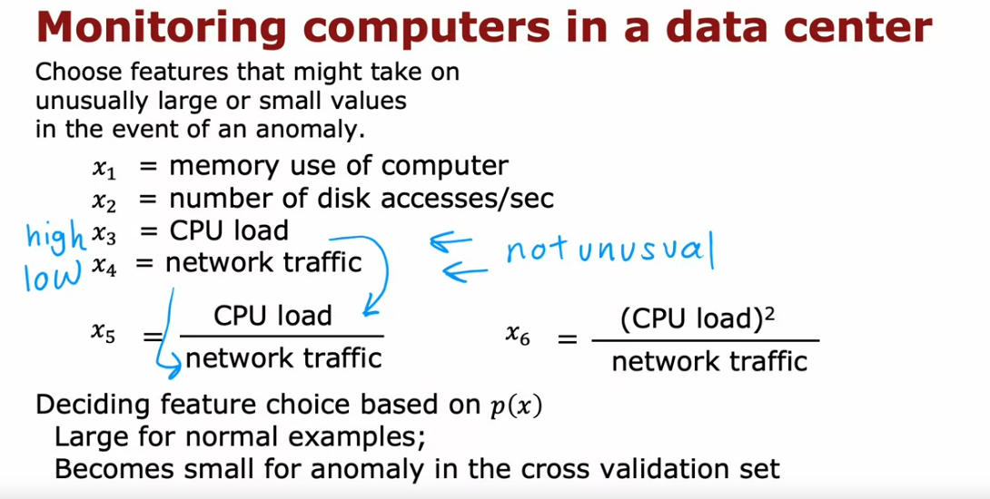
[2] Another practice is to choose features that might take unusually large or small values in the event of an anomaly.
Error Analysis for Anomaly Detection
After transforming the features and fitting the model, if the model does not perform well, we can also carry out error analysis as follows: Adding new features that represent the anomaly in case it is missed or not captured in the current training set. These could be new features or feature interactions.

Slide 20
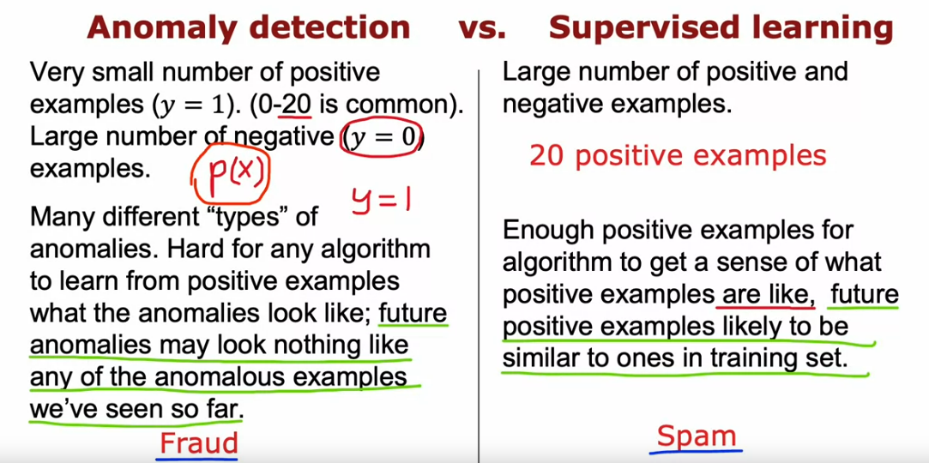
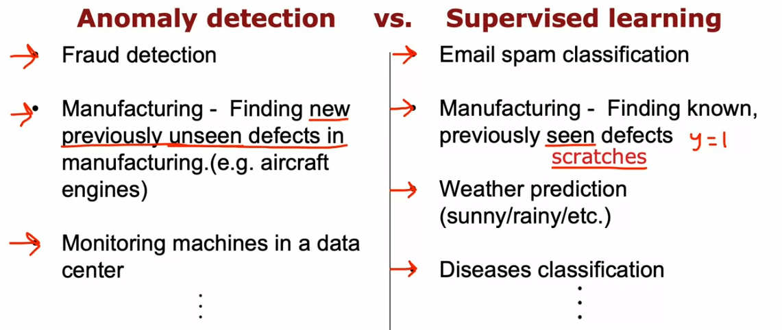
Anomaly Detection vs Supervised Learning
Anomaly detection tried to find brand new positive examples that may be unlike the data seen before, whereas supervised learning looks at positive examples, and tried to decide if future examples are similar to the positive examples that have been seen.

Slide 21
RECOMMENDER
SYSTEMS

Slide 22
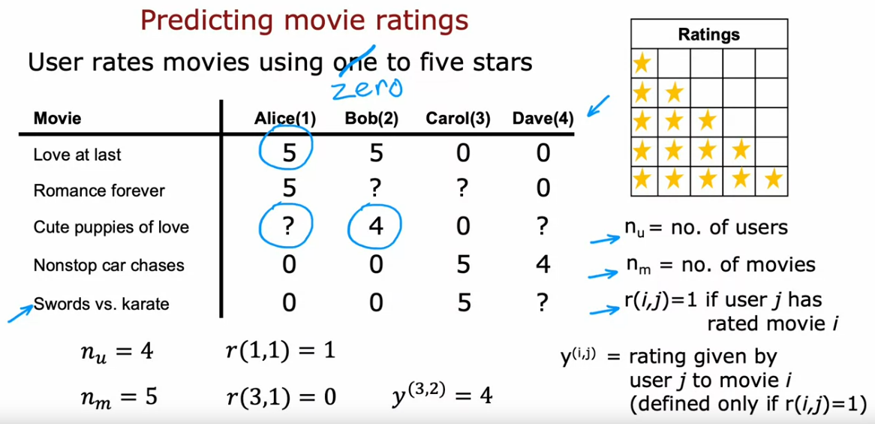
COLLABORATIVE FILTERING
The economic value driven by recommender systems is very large
In a typical recommender system, you have some number of users and some number of items. The items are to be recommended to users based on RATINGS.
Notation:
nu = number of users
nm = no if items
r(i, j) = 1 if rating for an item available (binary indicator)
y(i,j) = rating given by user j to item i (defined only if r(i, j) = 1)
One of the ideas of recommender systems is to predict items not rated. This can then help decide if the item can be recommended or not.
To create a recommender system, we will first assume we have extra features available for each of the items. We will then remove these assumptions and develop the algorithm.
Part 1 – Features Available (per item)
Additional notation n will be used for tracking the number of features.
Also, let x(1), … , x(n) denote the feature vector

Slide 23
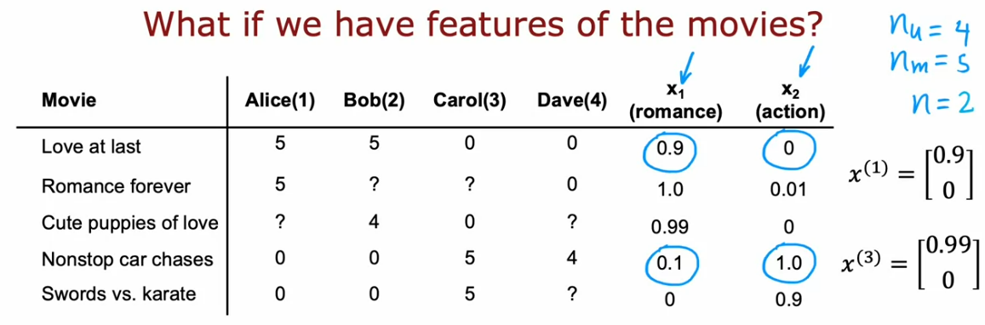
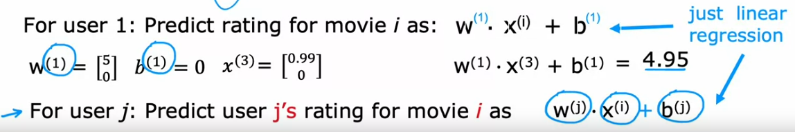
Now, in order to predict the rating for User 1, Item 3: assuming w(1) will be calculated as [5 0] and b(1) = 0, and superscript 1 indicates user 1, and x(3) indicates the feature vector 3:
Thus, we find w and b for each user, and use them to predict the missing rating values for user(j), movie(i). Basically, we are fitting a different linear regression model for each user. Thus, for each user, we have a certain w vector.

Slide 24
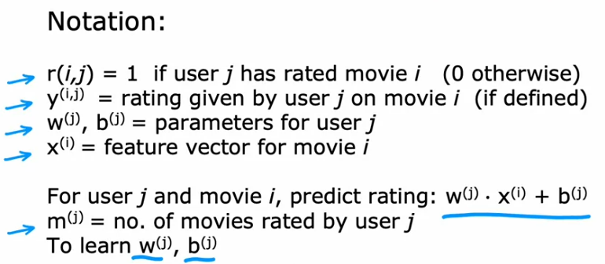
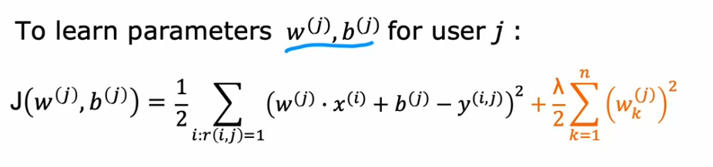
For the cost function, we are trying to minimize the squared error between the predicted rating and the actual rating for each user only for the item rated. Thus, it’s the cost function for linear regression but only considering the items rated. We can also add the regularization term. Additionally, we remove the 1/m parameter from the cost function because it is a constant in the cost function expression

Slide 25
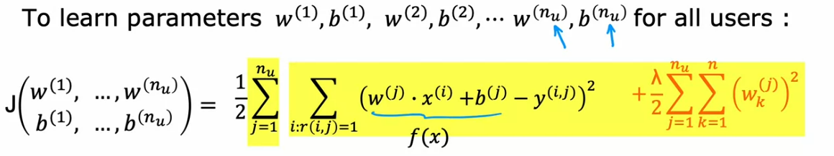
To learn the parameters for all the users, we can take the cost function of the single user and sum it for all users. Basically, we sum up the individual costs and regularization parameter term for all the users to get the total cost
We can now apply gradient descent to find a good set of parameters for predicting the ratings of all the users.
Part 2 – Features Not Available
In this case, we first learn how to come up with features x(1), … , x(n).
Since we have ratings from each user, we estimate the features using the ratings. The logic is to estimate the feature vector such that multiplying it by w and adding b will lead to the rating of the user for which the rating is available. Basically, in this case, we take advantage of the ratings already available to estimate the feature vector in such a way that given w, b for the item already rated by the user, it will lead to the rating already available.
The complete cost function will:
Estimate features based on the ratings available
Predict ratings for the items where rating not available (same as Part 1)

Slide 26
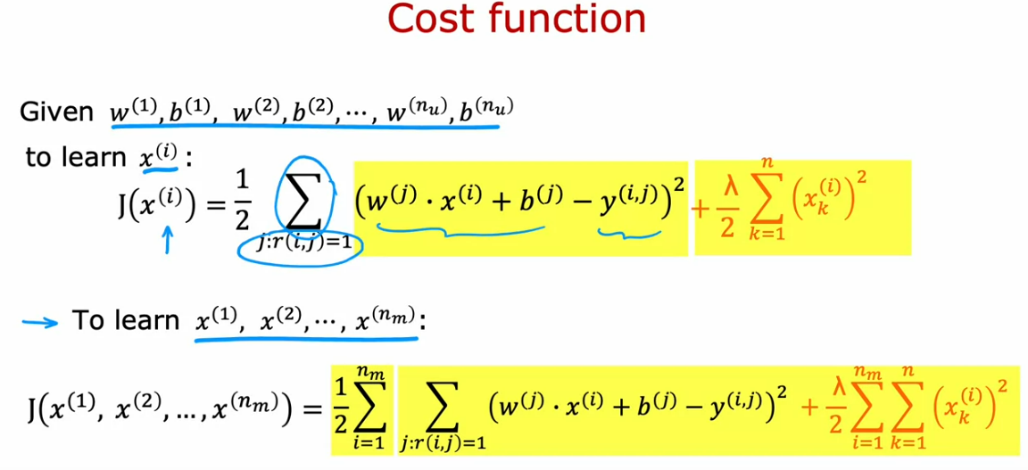
Note: the below cost function assumes we have weights and biases initialized to begin with
In most ML algos, the features have to be externally given but for collaborative filtering, we learn the features from the given ratings.
Thus, for the collaborative filtering algorithm, we use a cost function that learns: w, b, and x

Slide 27
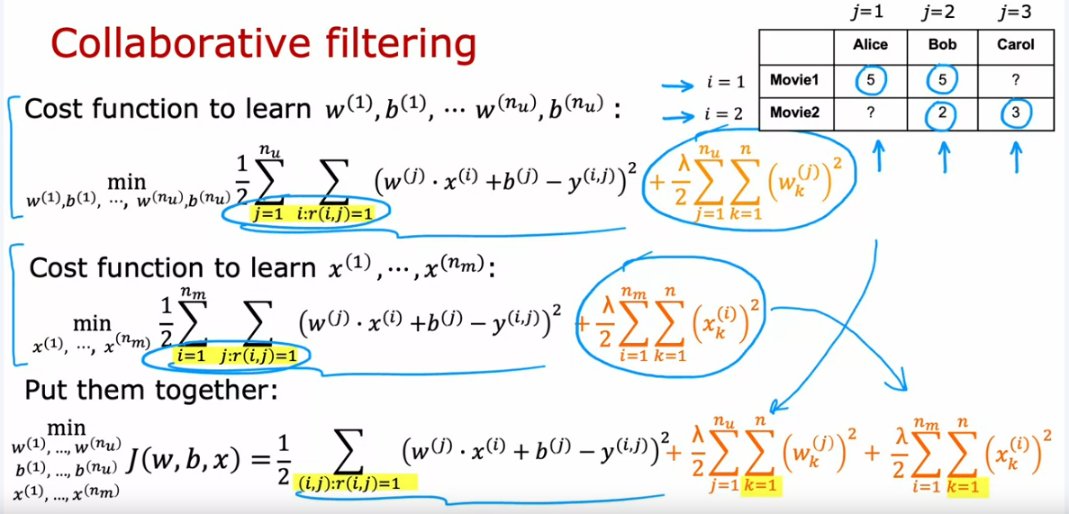
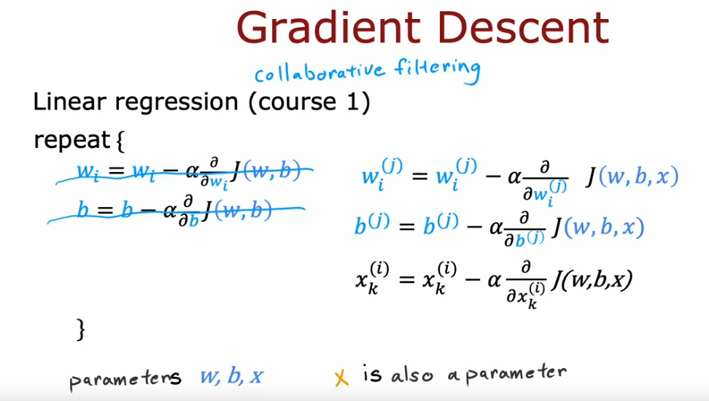
The intuition is that we first sum over all the items (row-wise) and then sum over all the ratings for each user (column-wise), for the non-missing data available and use this information to calculate parameters w, b and x.
To minimize the collaborative filtering cost function, we use the gradient descent algorithm and keep track of w, b and each x feature.
Thus, collaborative filtering means we use a collaboration of all the information available from all the users and items to first guess the features of the items which in turn allows to make predictions for new/unknown users.

Slide 28
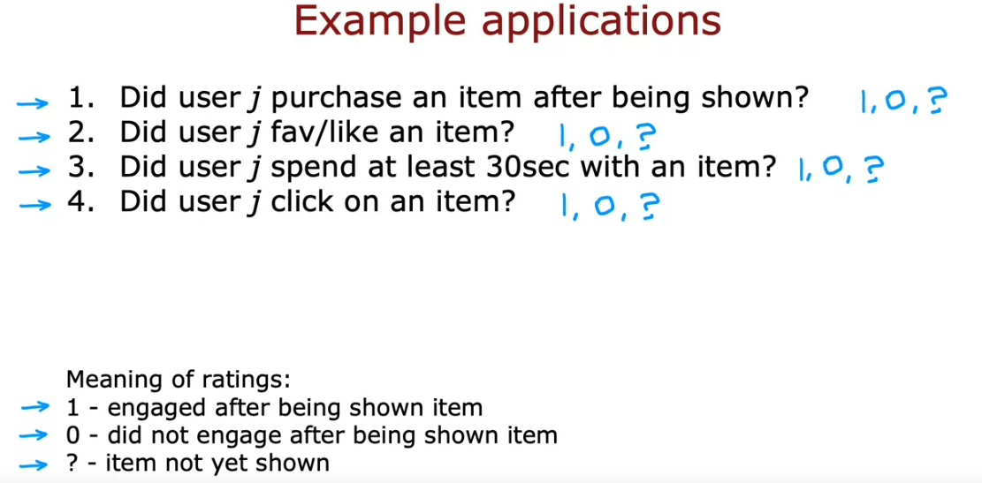
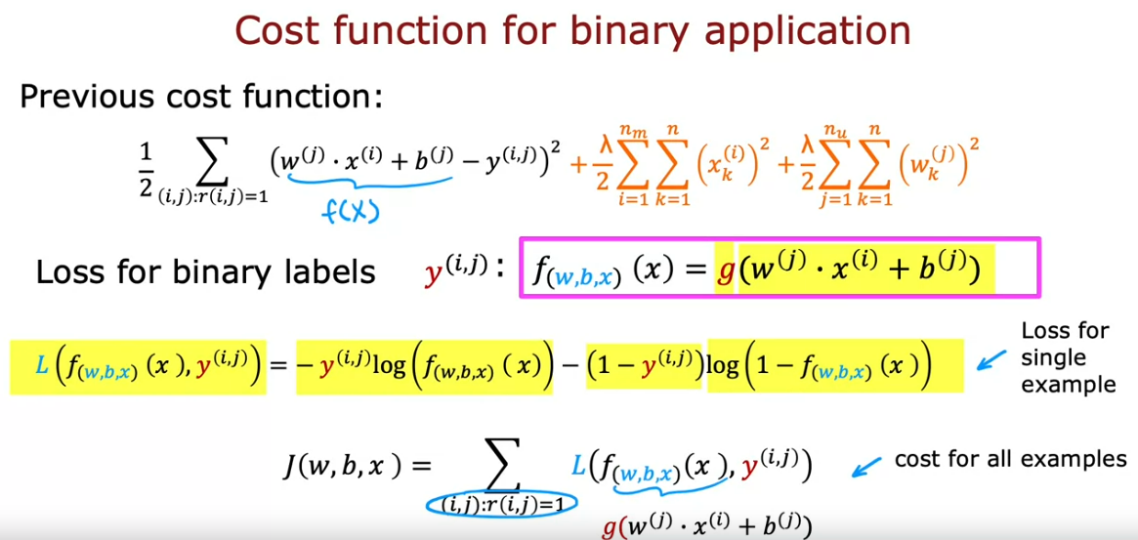
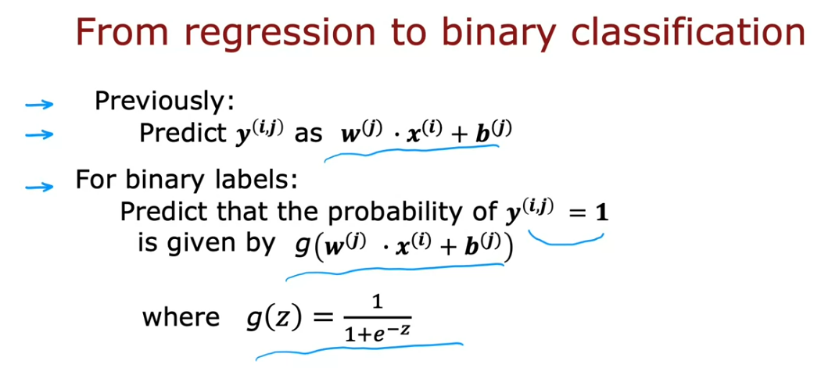
Collaborative Filtering for Binary Labels
This process of predicting binary labels is very similar to going from linear regression to logistic regression. In this case, the final predicted value is a probability score. Also, instead of using the linear function, we use the logistic (sigmoid function). We also modify the cost function from squared error to binary cross-entropy log loss.

Slide 29
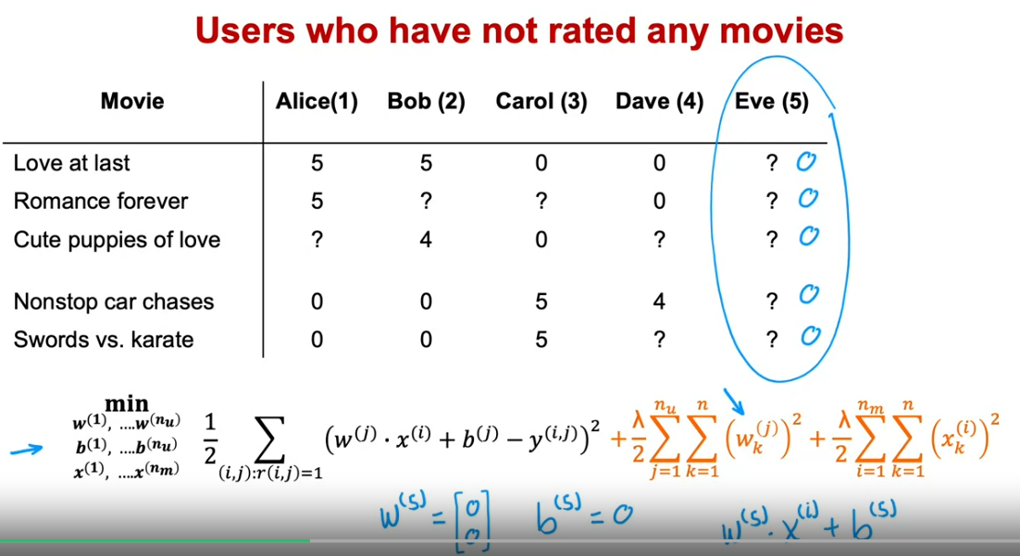
Collaborative Filtering implementation details
Since the range of numbers in the training dataset can take up different values, the recommender system algorithms can run more effectively if we first carry out mean normalization. This means, we normalize the ratings to have a consistent average value. This also helps handle the cases where no items have been rated by the user, in which case the parameters w,b can turn out to be zero.
To carry out mean normalization, we take all of the ratings and transform them into a matrix format. We then compute the row-wise average (which means the average rating for each item) of just the users for which ratings are available. We then subtract the mean rating from each element in the row. We then use this matrix to train the algorithm.
Since we perform mean normalization during training, we also have to add back the mean during prediction to ensure we do not get a non-negative return. This way, any new users that have not given any ratings or have given very small number of ratings will be predicted to have mean as their rating (check EVE)

Slide 30
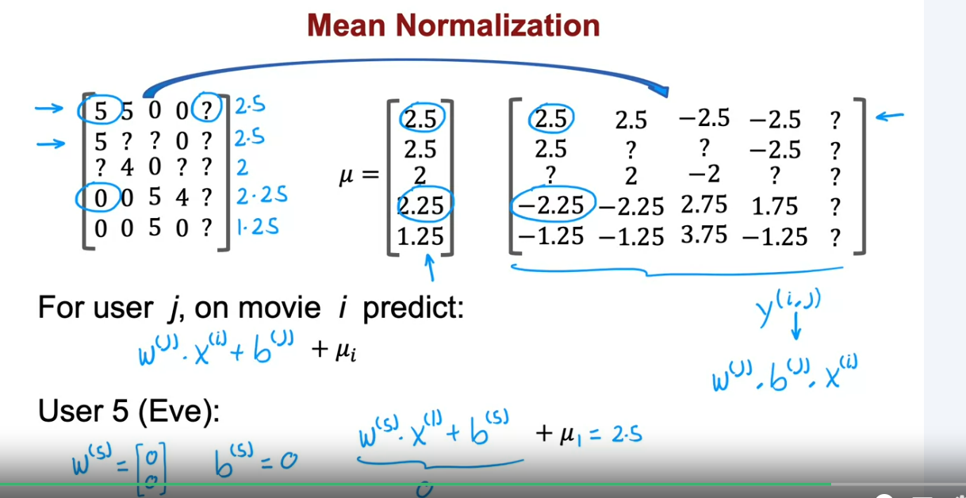
Sometimes, normalizing the columns instead of the rows can also be helpful, but this choice depends on the application – this works for use cases where there is a brand new item that no one has rated yet. Thus, mean normalization has 2 benefits:
It makes the algorithm run faster
Makes reasonable predictions for new users/items
Finding Related Items
The collaborative filtering algorithm has a nice way in-built to find related items. The learned features, though not easy to interpret, do provide some information on the items and ratings. Thus, if we find features for items similar to each other, we can group them together by finding the squared-distance between the features and choosing the top-k similar features

Slide 31
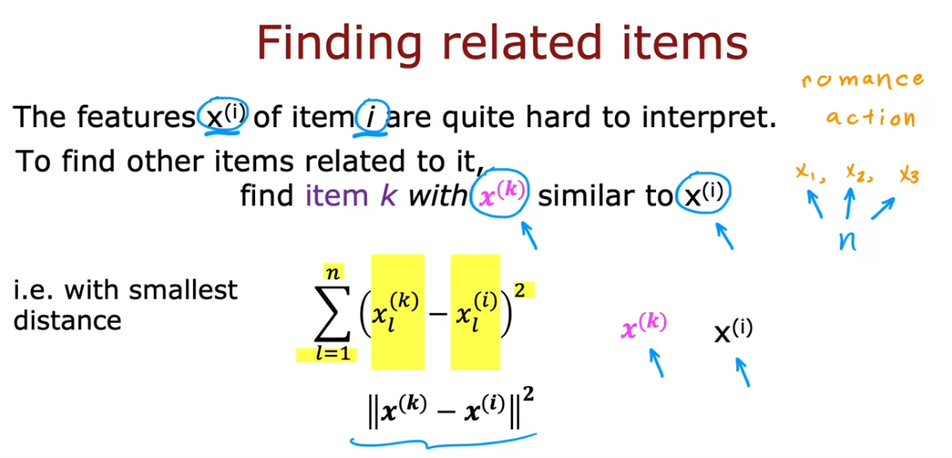
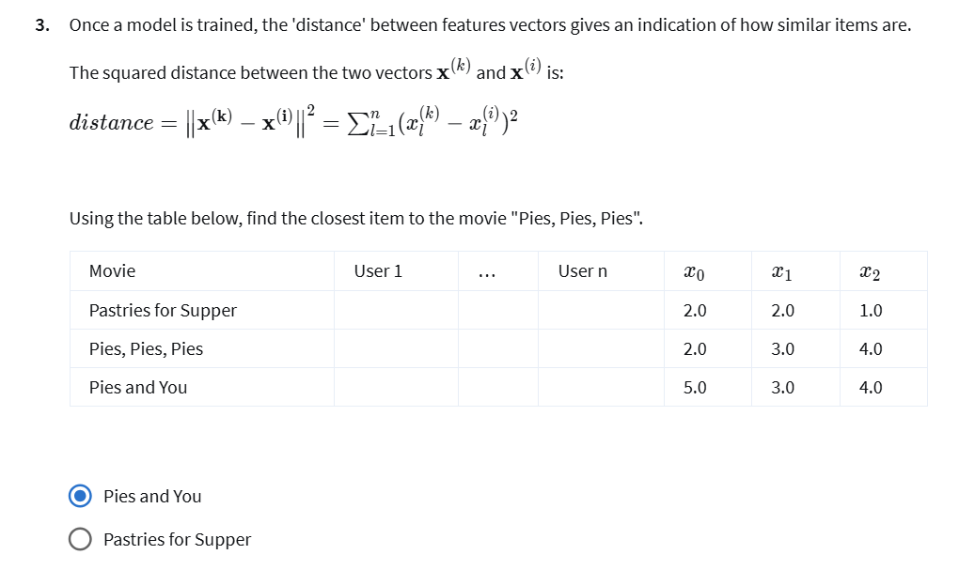
Note – we calculate the horizontal/row-wise squared distances to find out similar features.
Limitations of Collaborative Filtering
It is not very good at a cold start problem – new items or very few ranked items. Even though mean normalization ties to solve this, it is still a limitation.
It does not provide a natural way to give additional information about items or users – there are many other features that can be calculated or derived from the existing training data. To solve this, we use content based filtering.

Slide 32
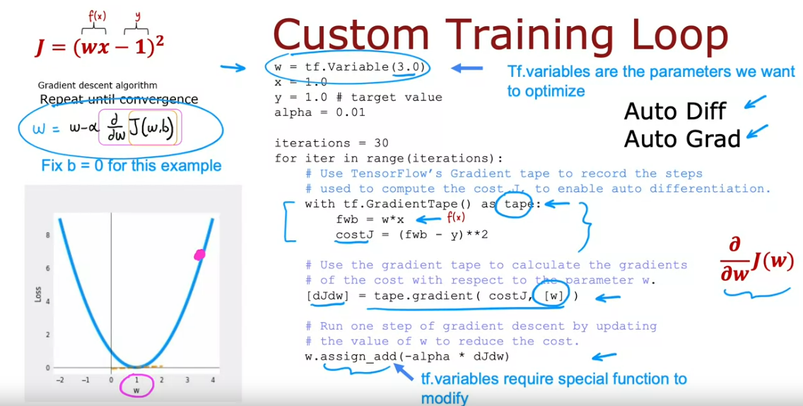
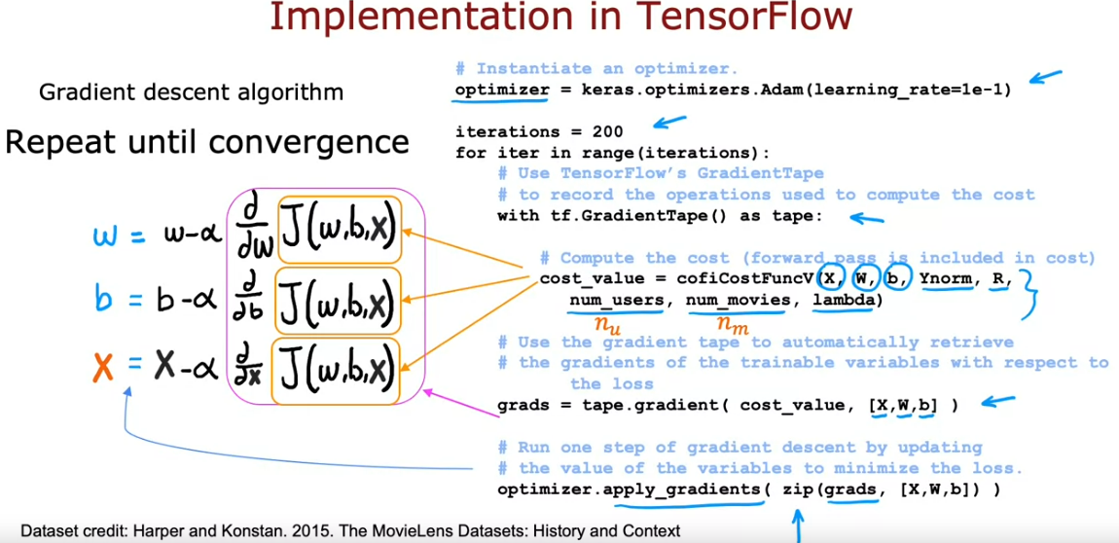
TensorFlow Implementation - Collaborative Filtering
The advantage of TF is that it automatically figures out the derivative for the cost function. It also saves the sequence of operations related to finding the derivate (in the example below, steps are saved in the tape variable)
For implementing collaborative filtering, all we need to do is figure out the cost function (cofiCostFunc in the snapshot) and provide its parameters in the gradient tape loop. The rest of the code is templatized. We can also update the optimizer to the ADAM optimizer.

Slide 33
CONTENT BASED FILTERING
Collaborative Filtering: recommend items based on ratings from users who give similar ratings
Content-based Filtering: recommend items to users based on user and item features by finding a good match
- In content based filtering, we continue to use r(i,j) to determine if user gave rating to an item, and y(i,j) is the rating given by user j on item i (if defined)
- We thus additionally construct a user feature vector as well, not just the item feature vector. The task then becomes identifying if the given item is a good match for a given user.
- The user and item features can be very different in size. There can be many more features available for the user than items, or vice-versa
- To predict the rating for user j for item i:
Compute the feature vector v_u from user features
Compute the feature vector v_m from item features
Compute a dot product of the feature vectors
Thus, the challenge becomes computing the vectors v_u and v_m succinctly/compactly from the user features and computing v_u and v_m to be the same size so that a dot product is possible.
To summarize, in content based filtering, we have features of users and features of items, and we want to find a match between the user and the items. This is done by computing vectors for users and features, and their dot product between them to find good matches.
The user and item vectors and found by passing their features through a neural network.

Slide 34
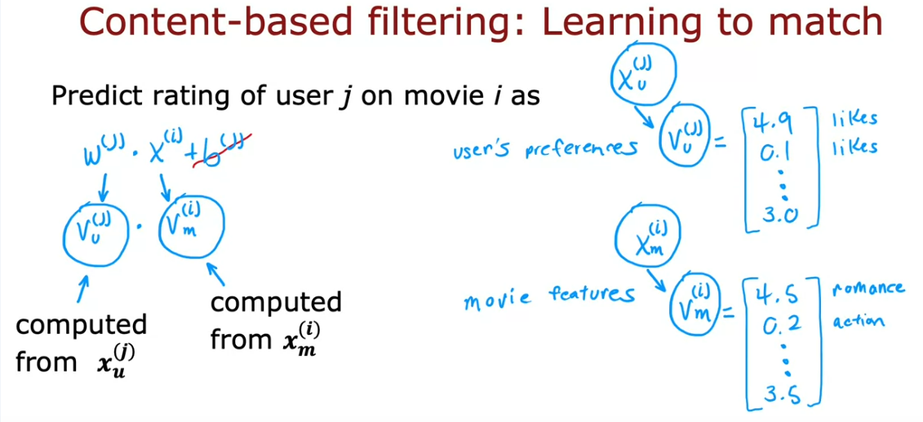
Deep Learning Approach
We first create a USER network by taking the user features and passing them through a dense NN layer. The output of the NN will be the vector v_u that describes the user. The final layer, in a lot of cases, has 32 units.
Similarly, for the ITEM network, we take the features of the items and pass them through dense layers of NN to output a vector v_m that describes the item.
The user and the item network can have different number of layers and units within each layer, but the output layers should have the same size/unit to compute the dot product for prediction. Also, to convert the prediction to a probability, we can also pass the prediction through a sigmoid function to scale the value between 0 and 1.

Slide 35


Assuming that there is some data available for the initial prediction just like in the case of collaborative filtering, we can use the following cost function to train the model:
Note: There is only 1 training procedure for both users and items, and the parameters for the item and user networks are not trained separately but together.

Slide 36

After training the NNs, it is also possible to find similar items – the vector v_m describes the item i, and to find items similar to i, you can look for other items in the same vector such that the distance between them is small. A similar idea can be extended to finding similar users. Also, these steps can be pre-computed outside of the algorithm/training process for new users/item.
One limitation of the above approach is that it is computationally expensive for a large catalogue and a large user base. To mitigate this, there are some practical issues that can be handled for the algorithm to work at scale.

Slide 37

Recommending from a large Catalogue
Many large scale recommender systems follow 2 steps: Retrieval and Ranking
Retrieve:
- During the retrieval step, a large list of plausible item candidates is generated for a specific user - To generate a list of plausible items, similar items can be calculated from the item feature vector. For example, in case of movies, this can be further classified into genres, countries, etc.
- We then combine retrieved items by removing duplicates or items already accessed by the user.

Slide 38

Ranking
- For this step, we can use the retrieved items and pass only them through the neural network to get the final predictions before displaying them to the users. This can be done at the user level, only for 1 user, thus making it much more faster.
Additional notes:
Retrieving more items will tend to result in better performance, but slower responses
To analyse/optimize the trade-offs, carry out offline experiments to see if retrieving additional items result in more relevant recommendations (i.e., if P(y_i,j)=1 of items displayed to the user are higher)

Slide 39

TensorFlow Implementation
In the code below, tf.linalg.l2_normalize(vu, axis = 1) normalizes the length of the vector vu to 1. Same for vm. The rest of the code is similar to the previous NN lab. Refer to the practice lab for more details.

Slide 40


Ethical Use of Recommender Systems
There are many ways of configuring recommender systems – the binary label y could be items liked, clicked, etc. A lot of companies try to recommend:
Ads that will generate the most revenues
Products that will generate maximum profit
Videos that may lead to maximum watch time
Thus, a lot of times, being transparent with these criteria can be helpful.

Slide 41
Principal Component Analysis

Slide 42
PCA
IF you have a dataset with a lot of features, PCA helps reduce the number of features to plot/visualize them.
PCA tries to focus on features having a meaningful degree of variation. The idea of PCA is to find one or more new axes so that when we measure the data coordinates on the new axes, we still end up with very useful information about the dataset, but only with fewer features/numbers.
In practice, PCA is useful in reducing very large number of features (>10) down to maybe 2 or 3 features for visualization.
How to choose new axes to represent higher dimension data into 2-3 features:
Preprocess the features to have zero mean and also perform feature scaling to ensure that the ranges of the features are not far apart
Choose axes such that the projection of the data/training examples is at a 90 degree angle to the axes. The word “projection” means taking the data point and finding its corresponding point on the z-axis using a line segment that is 90 degrees.
The z-axes are chosen such that they capture the maximum spread of the data. Alternatively, we are capturing the variation/variance in the data/feature.
The axis that captures the most variation is called the Principal Component. Sklearn can help automatically find the principal component.

Slide 43



In terms of the algorithm logic:
Choose one axis as the PCA axis (z-axis)
Get the length 1 (unit vector) pointing in the direction of the z axis
Do a dot product of the original coordinates with the unit z-vector to project it on to the z-axis. The dot product then becomes the new feature representation.
After finding the first PCA axis, the second axis will always be perpendicular to the first axis. The next axis will then be perpendicular to both the axes, and so on. We can then make 90 degree projections on these axes.
Maximizing the spread of the projections corresponds to minimizing the distances of the points and the line segments.

Slide 44


PCA is not Linear Regression
In linear regression, we try to fit a straight line through the data so that the predicted value (value on the straight line) is as close to the ground truth value as possible.
PCA being an unsupervised learning algorithm, there is no ground truth label, and we try to find the axis z that makes the projected line segment as small as possible.
In linear regression, the target label Y is given a special treatment – the algorithm is trained to fit values as close to Y as possible
In PCA, all features are trained equally and the goal is to retain variance.
The goal of linear regression is to predict Y
PCA is used for reducing feature dimensions and visualization

Slide 45

PCA as an Approximation
There is a step in PCA called “reconstruction” in which we try to go from the projected number back to the original number. This cannot be done exactly, but multiplying the projected value with the unit vector on the z-axis can provide an approximation
To summarize, the PCA algo looks at the original data and chooses one or more new axes (z) to represent the data. By taking the original data and projecting it onto the new axes, this gives a smaller set of numbers to plot/visualize the data

Slide 46



PCA Code - Sklearn
Applications of PCA
Reduction and visualization of features
Data compression (less frequent) – to reduce storage or transmission costs
Speed up training of supervised learning model (less frequent)

